Slide 1
Navigating the virtual world
j.aleta.villanueva@upou.edu.ph
UP Open University

Slide 2



















Where am I now?
Notes:
Hi Im Prof V at UPOU. Even as an assistant professor, I still consider myself very much a teacher and a lifelong learner. This is where I am now. You see here the tools I have started using as teacher-learner-researcher. These are some sites I frequently visit to be in the now of technology. Then of course I’ve recently membered myself in classroom 2.0 where I get to observe the interests of a wide range of teachers eager to learn about the web 2.0 and its application at the basic education levels. Then of course a recent favorite is IT4ALL—this is where I am currently taking courses in Moodle Administration as Im getting curious about how Moodle works from the backend, and how its use can be maximised for K-12 students.
But then it took me quite a number of years to get here.

Slide 3


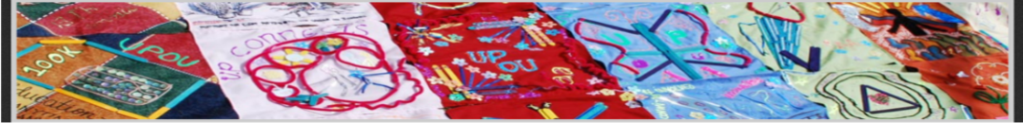


WHERE/HOW was I a Few Years Back?
Notes:
This was how I was before…it all started from being a member of a virtual community. This is the UPOU Community Site authored by Sir Librero, a co-faculty from UPOU. Though now it is no longer up and running, I will always look back to this first hive where I tried to figure out what it means to be part of an online community. I didn’t have any any FB then or perhaps refused to have one. Ayoko lang sumabay sa uso.

Slide 4
What does it mean to be part of a virtual community
(=VC) ?
“The community site, for me, is like a “hive” where UPOU students and faculties alike can create, exchange and discuss ideas in a fluid and less grade-centric online environment, compared to the university’s Moodle...”
--BGomez, former AA student, now w/BAMS
Notes:
But Comm site gave the space I needed to get to know some students who are representative of the population I am handling as program chair.
Becoming a member of a virtual community has taught me a thing or two. Let me share a few bits from my students.

Slide 5
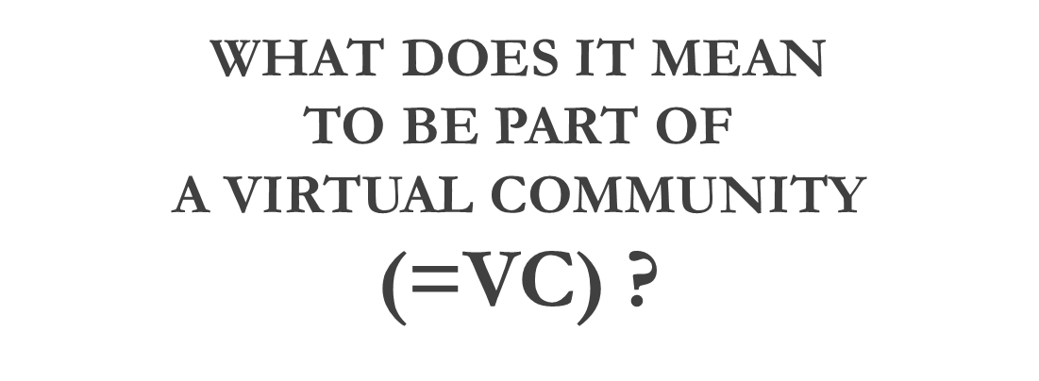
I have learned that it is important to have such a site
because it makes Distance Education
more bearable and not so distant.
It gives the student a sense of belongingness
to a "real" group
by helping and supporting each other
with their UPOU concerns and beyond...
it becomes more special and unique
because there are no borders that is created
by the four corners of a classroom.
--MdeGuzman, AA Grad
Notes:
I equally shared these observations and sentiments about the community site with student members.

Slide 6
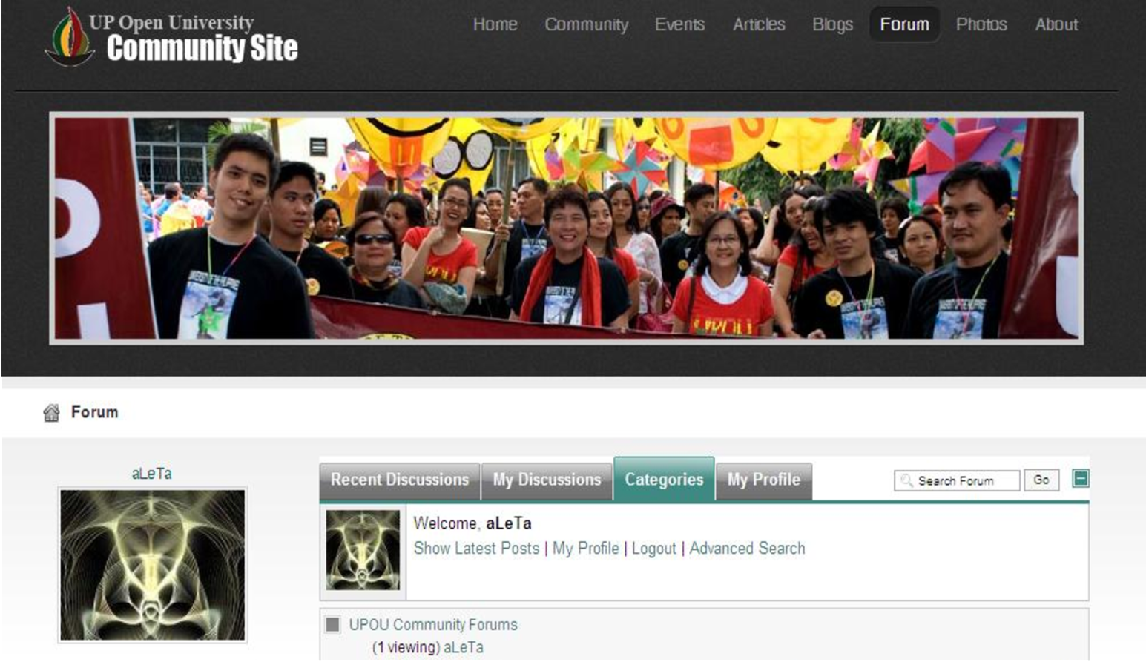


VC=
Building an online identity
Notes:
From my view, being part of a Virtual community is not just about having a forum for exchange…contributing bits of yourself to a virtual community is all about
Building an Online Identity—
No matter how I tried to be myself, OR make a fool of myself in order to level with my students I can never escape the fact that I will always be treated as a UP Faculty. I gradually embraced that part of me.
But the good thing about becoming part of a community site is that I know I can let my guard down and be human—that also means I cannot cover up for UPOU’s mistakes (nor I consider that to my job) Students need to see that UPOU is also just as human and we equally strive for excellence in providing student support.
Being human means we can also afford to use our intelligence—to talk about a range of topics…from the most mundane to pressing issues which greatly affect who we are as UPOU folks---

Slide 7
(VC =)
Building a Sense of Community
“The Community site was where I met new friends and it was the catalyst that helped me overcome my shyness and be an active student in UPOU. I've learned that all of us students share almost the same concerns, we have the same quirks, and that we almost always feel the same way about certain
issues in the university.”
--Jeizelle, AA Graduate
Notes:
Being part of a VC is ultimately about building a sense of community.
But we weren’t all that corny and mushy. We were also out to have fun hence the site became served as our online brainstorming and planning for some community events.

Slide 8
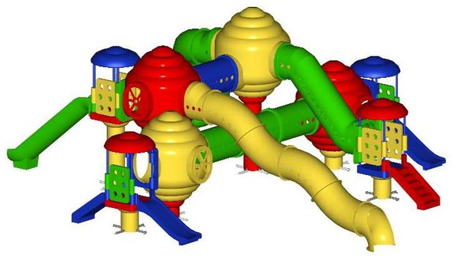
(VC=) learning more about the virtual world of….
Toyls
Notes:
The fun to me carried over to my search for other sites where I can learn more about the world of virtual toyls

Slide 9




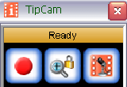
Toyls tools…or more like toys which make work enjoyable
Notes:
This was the phase when pioneer members have moved on with their lives and I moved on as well to other experiments. The ongoing experiment for me will always be all these toyls you can use to teach, learn research etcetera etcetera.
My explorations with these toyls I picked up from attending online conferences over at WizIQ, reading this and that from the net to get me jumpstarted into going inside Moodle. Experimenting with these was also the best way to delay work.

Slide 10

(VC= )
Contributing to
A network of educators
Notes:
Now I find myself taking part in other sites and activities through a few networks.

Slide 11

Where am I now?
Notes:
So in other words, being part of virtual community has now taken me here!
I would like EDEN to be part my of PLN.

